Slide 1


STATION
49
ssimui Naver blog PPT theme
@ssimui

Slide 2
02. CONTENTS
- Subsidiary contents
- Subsidiary contents
- Subsidiary contents
01
02
01. CONTENTS
- Subsidiary contents
- Subsidiary contents
- Subsidiary contents
Table of
CONTENTS
03. CONTENTS
- Subsidiary contents
- Subsidiary contents
- Subsidiary contents
03

Slide 3
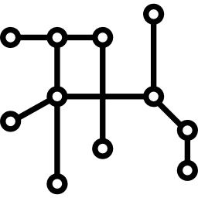
CONTENTS 1
01
SUBWAY STATION
NEXT STATION IS GANGNAM
YEAH-!

Slide 4

CONTENTS 2
02
RAILROAD
ONE, AND TWO, AND TREE
SUBWAY AND RAILROAD

Slide 5
CONTENTS 3
03
사용된 글씨체는 맨발의 청춘체입니다.
네이버 소프트웨어에서 간편하게 다운받으실 수 있습니다.
용도에 따라 L, R, B를 사용해주세요. @ssimui naver blog

